Slide 1

Case Study: Global Online Orders
PABLO ALFARO
NICCOLÒ CLOETTA
GIACOMO SALZA
DANS LISMANIS

Slide 2
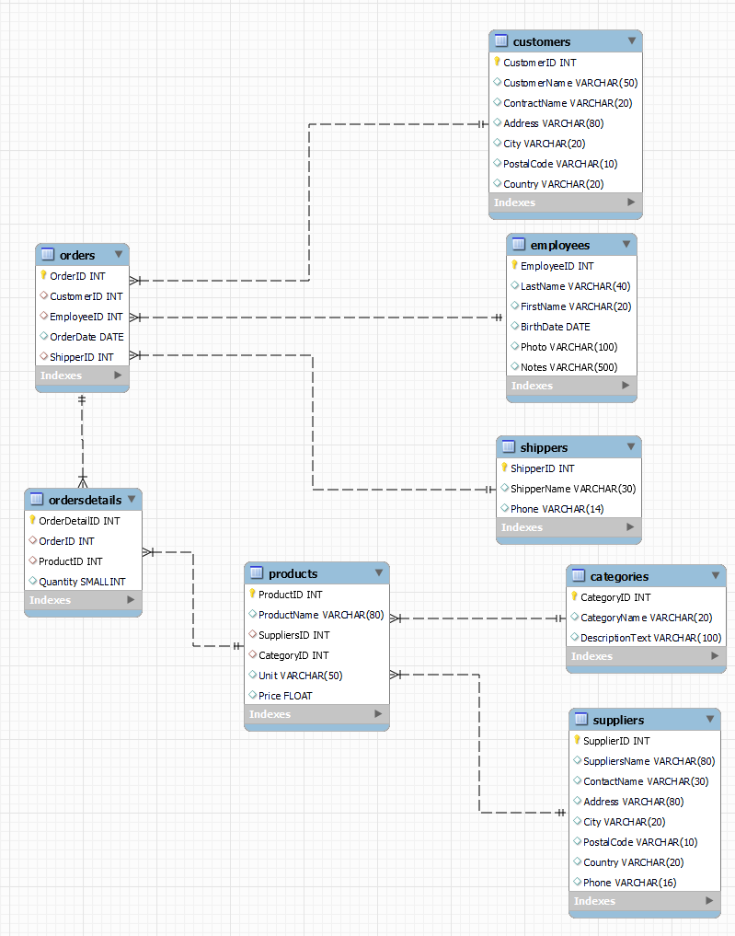
Aim of the project
A well-known e-commerce platform which specializes in the sales of food has contracted us to evaluate their business
We have been provided with their operational data and have been asked to evaluate the most important sectors of their business: customer, sales, suppliers and employees
We decided that the most effective way would be to provide graphs to visualise the data in order to draw insights that would allow improvements in business decisions
Schema of the e-commerce store data base

Slide 3
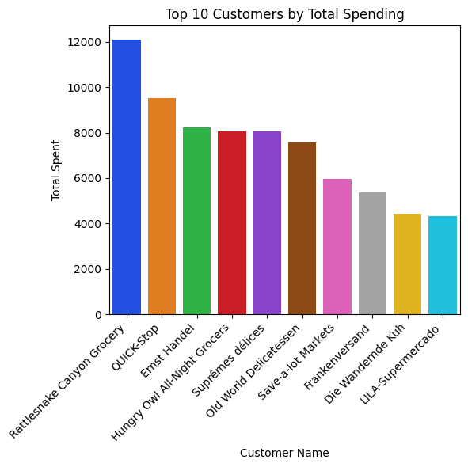
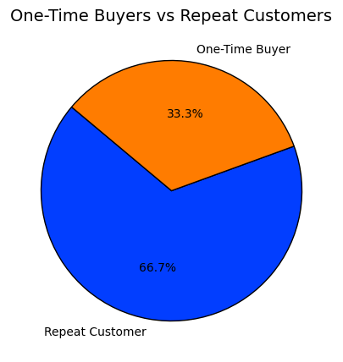
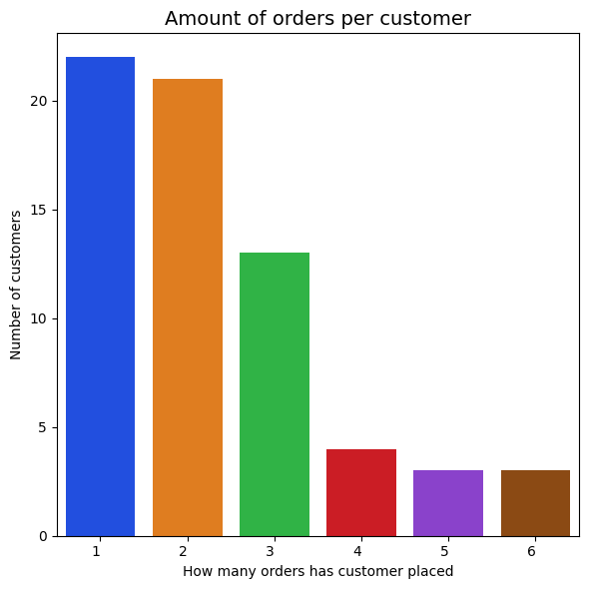
Customer Analysis
It is clear that “Rattlesnake Canyon Grocery” is the largest customer. There is a significant gap between the second largest. This outcome could help improve retention and refine marketing strategies
Most (66%) of customers have placed more than one order. Although this is not low, we can see that investing in customer retention might be necessary
The graph above gives a more in-depth view of customer retention. There is a large drop off between number of customers who have placed 2,3 and 4 orders

Slide 4
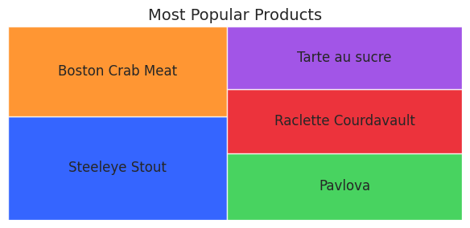
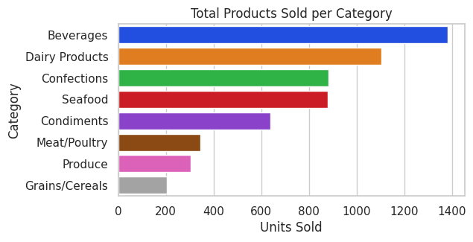
Sales Analysis
The graph gives us a good understanding on what kind of products are the most sold, and the least sold. This way the company can adapt their strategy to maximize profitability
We can analyse the amount of units sold by category to understand the market demands and the needs of the customers
The graph above highlights the most in-demand product, offering insights into customer preferences and market demand
The size of the blocks correspond to their demand (the larger the block the more in demand the product is)

Slide 5
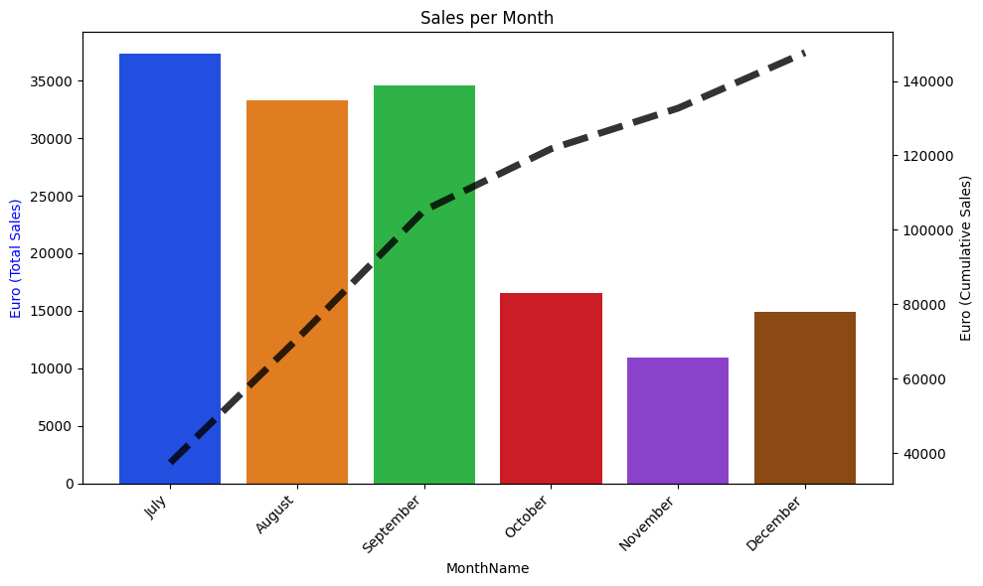
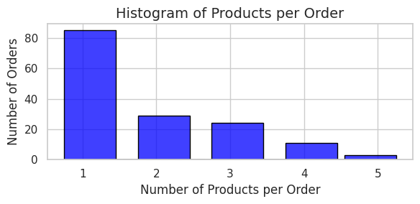
Sales Analysis
The histogram displays the order distribution by product count, offering insights into customer behavior and optimizing sales and logistics
This graph shows the sales per month as the bar chart with the values on the left axis and also the cumulative sales over the months as the dashed black line with its values on the right vertical axis
This visualization helps analyze sales trends, identify patterns, and optimize inventory and marketing strategies

Slide 6
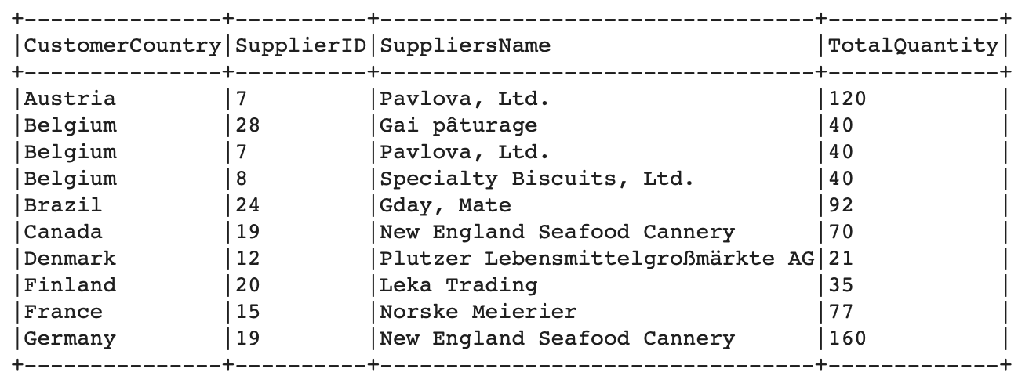
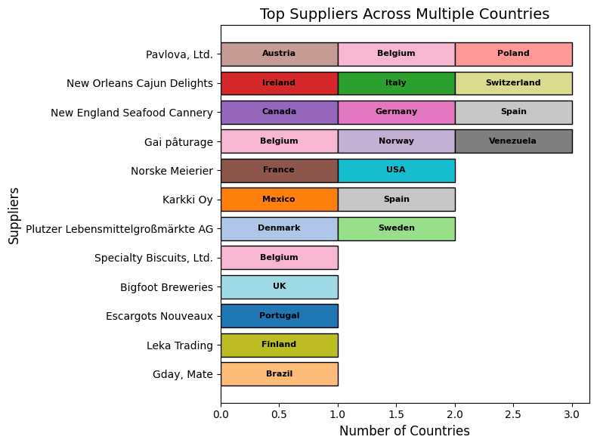
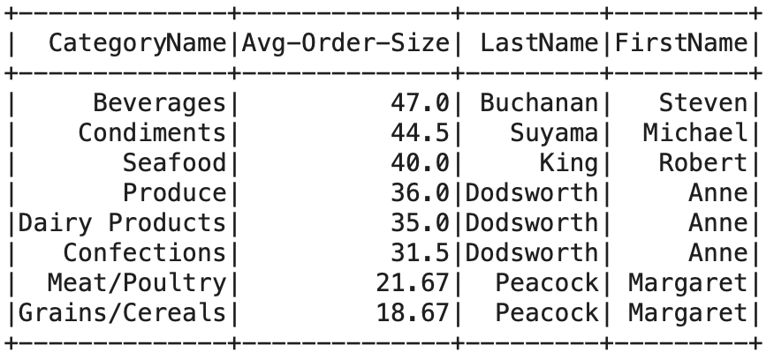
Supplier and Employee Analysis
In this query we find for each country the biggest supplier based on units sold. This allows us to create the visualization on the right
We obtained a visualization of the supply chain by location, to see the the positioning of our suppliers in their respective countries in relation to our company
This chart gives us an understanding of the order sizes for each category. This way the company can modify their supply to increase utility per units sold

Slide 7
THANK YOU!

